Slide 1
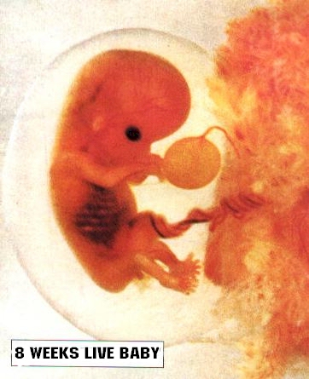
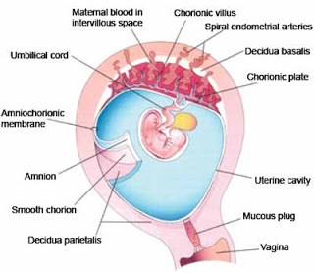
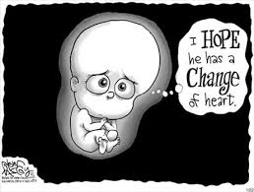
Abortion
Dr. P. Paranitharan

Slide 2
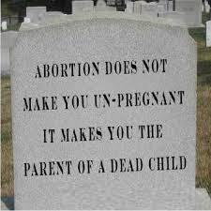

Slide 3
Objectives
At the end of this lecture the student is expected to know
The definitions of different types of abortions
Laws related to abortion in Sri Lanka
Methods used for criminal abortions
Common complications following a criminal abortion
Diagnosis and investigation of a criminal abortion

Slide 4
Abortion
Forensic pathological interest in pregnancy revolves almost exclusively around deaths associated with abortion either criminal or legally induced

Slide 5
Definitions
Abortion- The term abortion is used when the contents of a gravid uterus is expelled before 28 weeks
After this it may be considered as a premature
labour. The term miscarriage is an older synonym for abortion
Induced Abortion
1. Legalized abortion
Medical purposes (therapeutic abortion)
Non medical purposes (legal abortions)
2. Illegal abortions- contravening the laws

Slide 6
Definitions
Spontaneous abortion- due to natural causes such as hypertension, pelvic disease, nephritis, uterine abnormalities, malformations of the zygote etc. Most of the time no specific cause is identified
Therapeutic abortion- In Sri Lanka it is an abortion carried out in good faith to save the life of the woman as the continuation of the pregnancy will result in the death of the woman
Criminal Abortion- In Sri Lanka it is an abortion carried out where the reason for carrying out the abortion is other than to save the life of the woman

Slide 7
Laws relating to abortions in Sri Lanka
They are described under sections 303 to 307 of the Penal Code
303- Whoever voluntarily causes a woman with child to miscarry shall, if such miscarriage be not caused in good faith for the purpose of saving the life of the woman, be punished with imprisonment of either description for a term which may extend to three years or with fine or both; and if the woman be quick with the child shall be punished with imprisonment of either description for a term which may extend to seven years, and shall also be liable to fine.

Slide 8
Laws relating to abortions in Sri Lanka
304- whoever commits the offence defined in the last preceding section without the consent of the woman, whether the woman is quick with the child or not, shall be punished with imprisonment of either description for a term which may extend to twenty years, and shall also liable to a fine

Slide 9
Laws relating to abortions in Sri Lanka
305- Whoever with intent to cause the miscarriage of a woman with child, does any act which causes the death of such woman, shall be punished with imprisonment of either description for a term which may extend to twenty years, and shall also liable to a fine.

Slide 10
Laws relating to abortions in Sri Lanka
306- Whoever, before the birth of any child, does any act with the intention of thereby preventing the child being born alive or causing it to die soon after its birth, and does by such act prevent the child from being born alive, or causes it to die soon after its birth, shall if such act be not caused in good faith for the purpose of saving the life of the mother, be punished with imprisonment of either description for a term which may extend to ten years or with fine or with both

Slide 11
Laws relating to abortions in Sri Lanka
307- Whoever, does any act under such circumstances that if he thereby caused the death he would be guilty of culpable homicide, and does by such act cause the death of a quick unborn child, shall be punished with imprisonment of either description for a term which may extend to ten years and shall also be liable to a fine

Slide 12
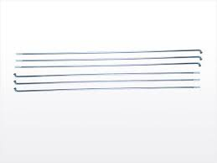
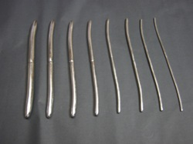
Methods used for criminal abortions and complications
Instrumental interference
Usually consists of dilatation of the cervical canal
From surgical dilators to metallic rods, cycle spokes and castor stumps
Dangers of instrumentation are bleeding and infection
Less common danger is cervical shock

Slide 13
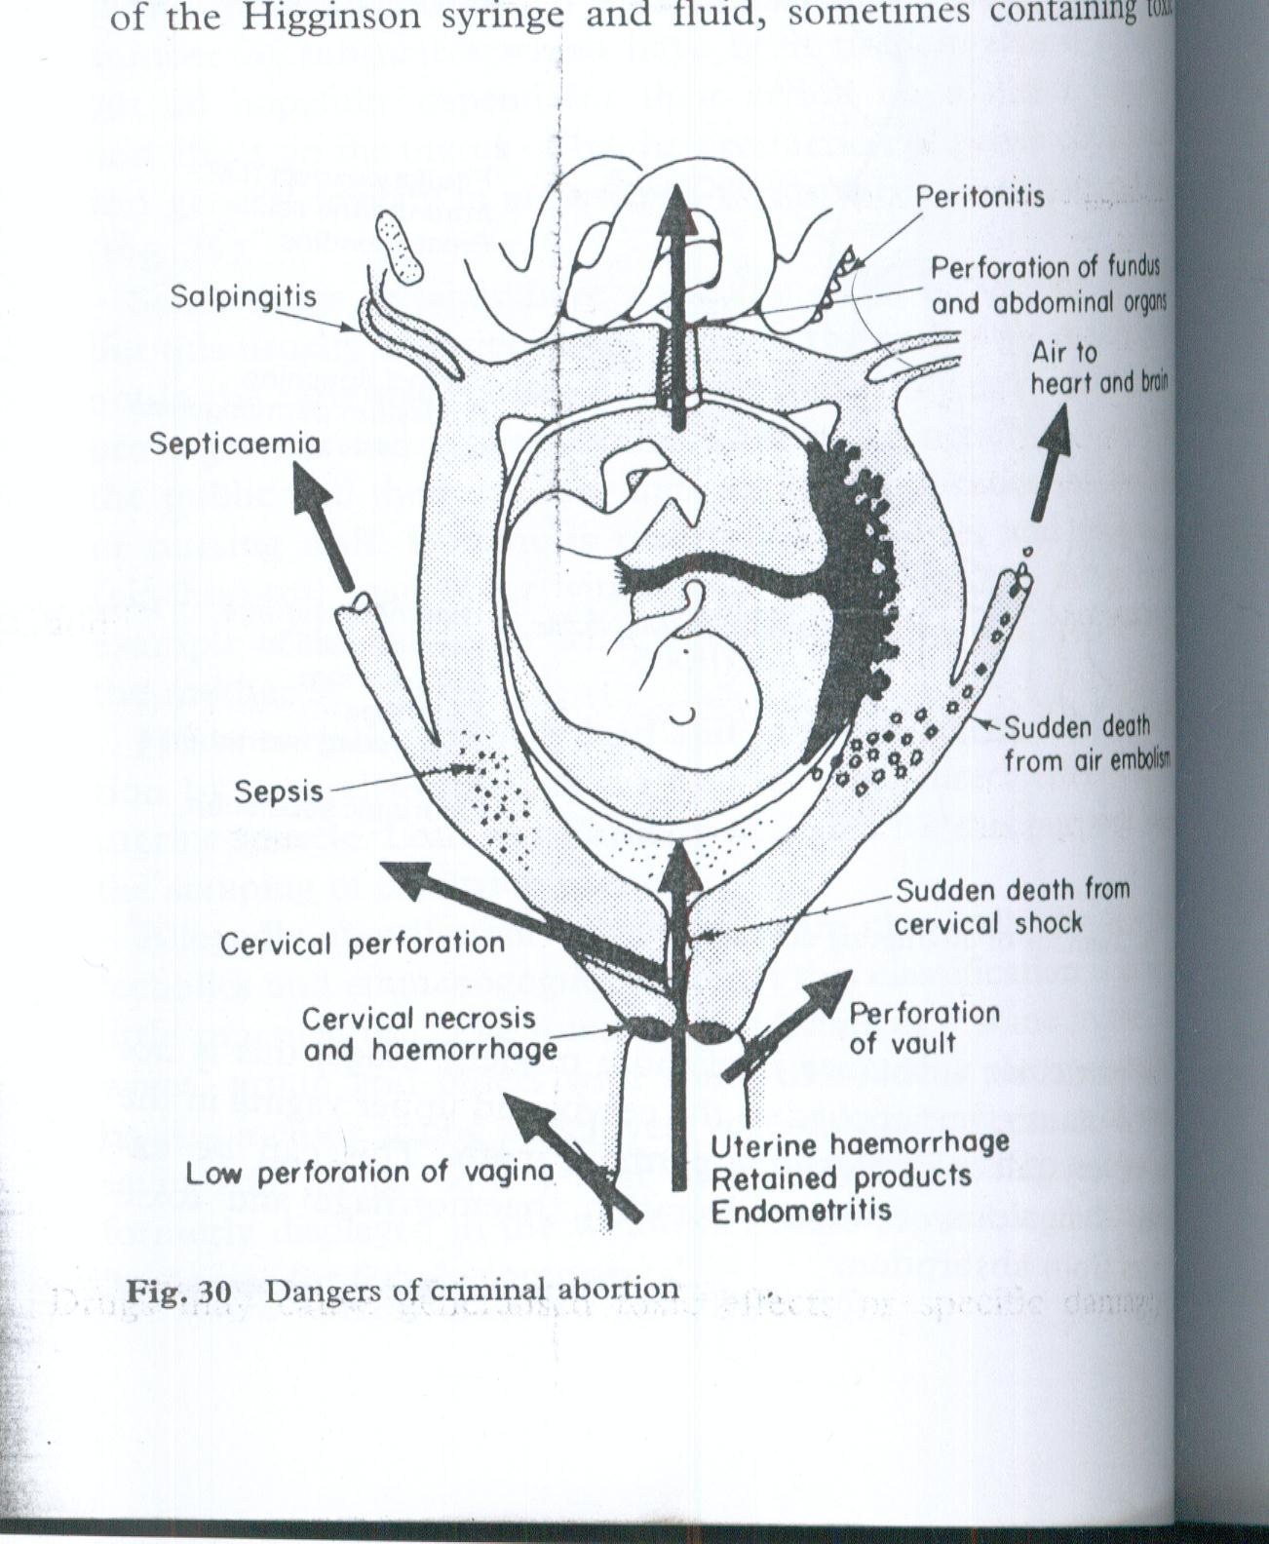
Dangers of criminal abortion

Slide 14
Common complications and deaths
1. Immediate- Vagal inhibition, complications of anaesthesiae
2. Early- Air embolism, Amniotic fluid embolism, Haemorrhage
3. Dealayed- shock, Renal failure, infections- due to injuries in the genital tract, uterus, other pelvic visecra, abdominal viscera and tetanus and gangrene

Slide 15
Amniotic fluid embolism
Entry of amniotic fluid into the maternal circulation
Amniotic fluid contains- fetal squames, lanugo, lipoid from the vernix, meconium and cells from chorion and amnion
The solid elements are usually impacted in the lung capillaries
The fluid is blamed for the allergic response that may cause such profound death

Slide 16
Amniotic fluid embolism
The diagnosis is histological and depends upon identifying the squames detached from the fetal epidermis in the capillaries of the lungs
These can be seen in the ordinary H& E staining but more visualised in special stains
Immuno- histochemical techniques have also been used in lung sections to demonstrate human keratin

Slide 17
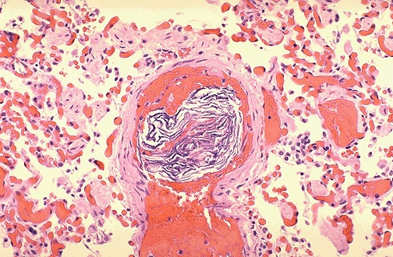

Slide 18
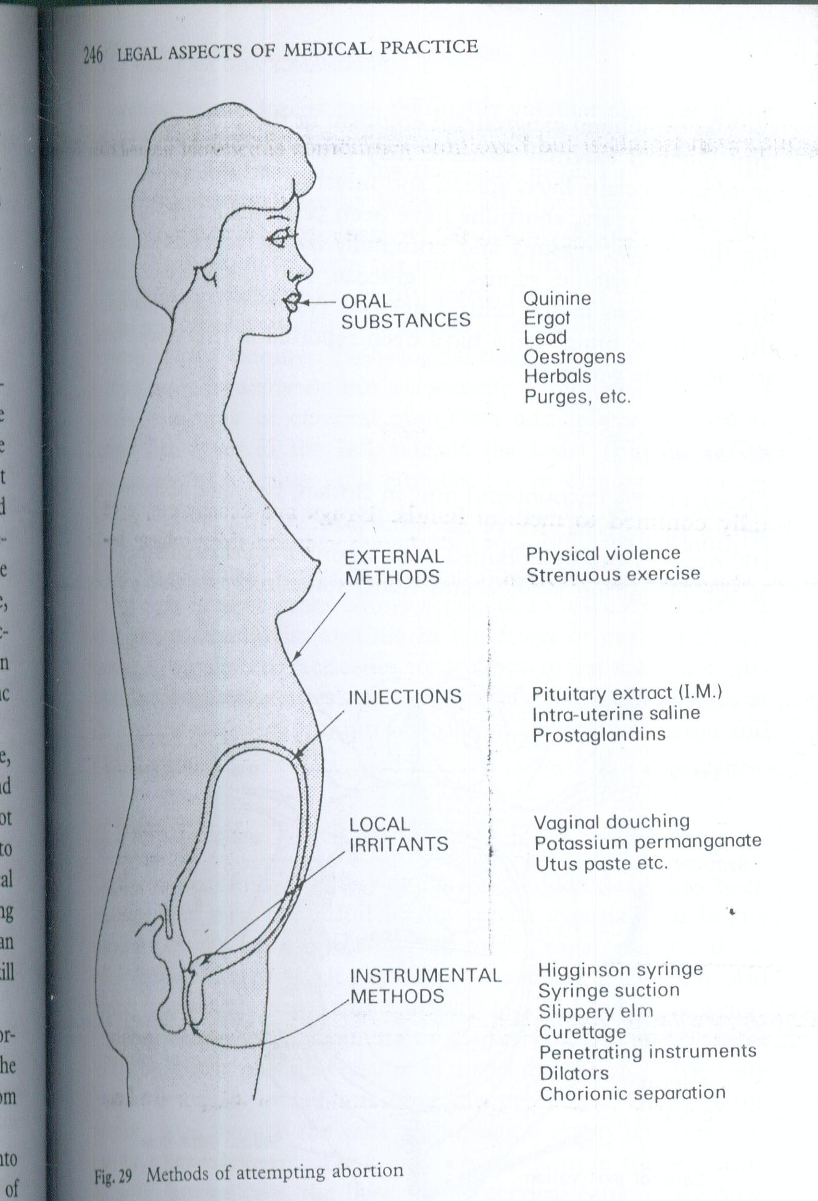
Methods of attempting abortion

Slide 19
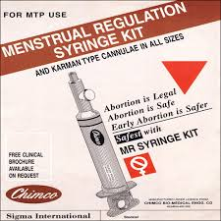
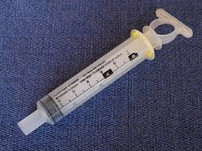
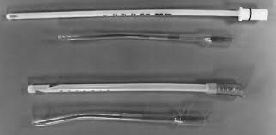
Methods used for criminal abortions and complications
2. Syringe aspiration
-A large syringe (50 ml) attached to a catheter or length of plastic tubing can produce suction within the uterus sufficient to rupture the chorionic sac and precipitate abortion ( Karman cannula: 5 mm diameter)
- Some products of conception may left behind that can form a focus for infection

Slide 20
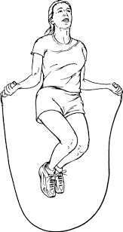
Methods used for criminal abortions and complications
3. Physical violence
Punching and kicking of the abdomen were most common
Violent exercise- skipping, jumping, horse riding
*Death from rupture of spleen, liver or intestine

Slide 21
Methods used for criminal abortions and complications
4. Suction termination
Useful up to 12 weeks
A syringe with a metal rod or rigid plastic cannula is introduced to the uterine cavity through the cervix and suction applied through a vacuum source
Infection, uterine perforation and haemorrhage are possible complications

Slide 22
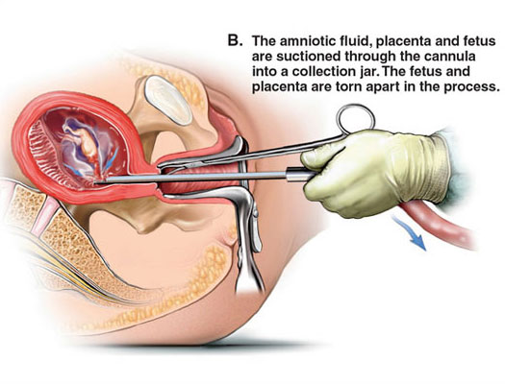
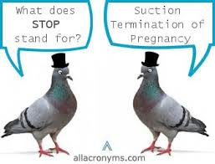

Slide 23
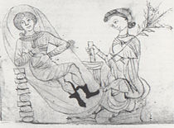
Methods used for criminal abortions and complications
5. Drugs and Chemicals
A wide variety of substances applied locally or taken by mouth
Pituitrin and prostaglandin. Prostaglandin induce strong uterine contractions
Ergot, Lead & quinine. They have a contractile effect on the uterine smooth muscle
Vegetable compounds like raw pine apple and papaw
Purgatives

Slide 24
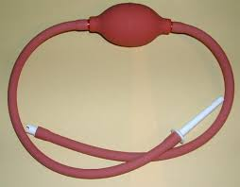
Methods used for criminal abortions and complications
6. Higginson’s syringe
The syringe was used to inject fluid into the uterus to separate the membranes from the decidua.
Death- Air and fluid is pumped into the placental bed and enter the venous circulation causing deaths due to air and fluid embolism

Slide 25
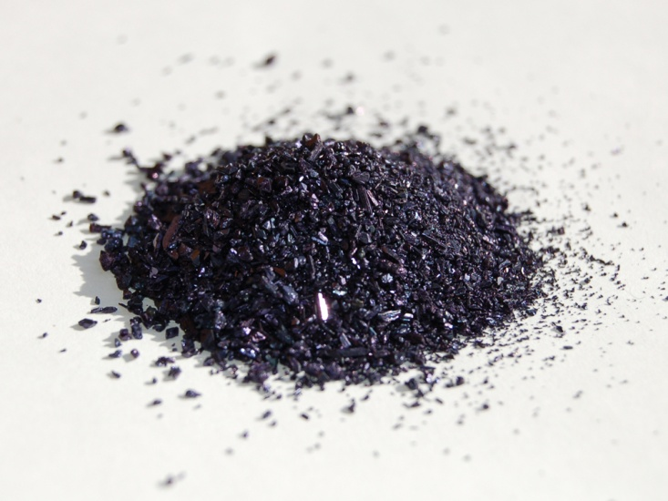
Methods used for criminal abortions and complications
7. Local interference
Application of chemicals to the upper vagina, cervix or the inner uterine wall
Eg: Pottasium permanganate- May cause local burns and death by manganate absorption
Utus paste- soap, thymol
- KI

Slide 26
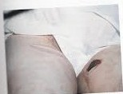
Burns from a hot water bottle

Slide 27
Diagnosis and investigation of a clinical case of suspected criminal abortion
MLEF/ Magistrate order
Consent
History
External examination- General, Specific
Genital examination
Investigations- Urine for HCG, USS abdomen
Referrals- Gynaecologist, Psychiatrist
Documentation

Slide 28
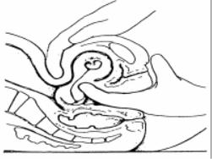
Signs of pregnancy
Amenorrhoea
Breast tenderness
Frequency of micturition
Nausea or vomiting
Leucorrhoea
Discoloration of vaginal walls, softening of the cervix, Hegar’s sign, breast and nipple changes, radiological evidence of fetal parts, biological urine tests

Slide 29
Proof of recent delivery
Uterus palpable above the pubis- till 10- 14 days
Dilatation and laxity of the vaginal orifice
Discharge of lochia-blood stained for 7 days and brownish for another week
Swelling and tension of the breasts with expressible milk after 3 days
Pigmentation of areola
Striae garvidarum of the abdomen
Softening and wide patency of the cervix

Slide 30
Evidence of abortion in living
If the examination of person closer to the time of criminal abortion then more signs could be visualized. Also depends on the duration of pregnancy
PV bleeding
Breast changes of pregnancy – more marked in the first pregnancy
Enlarged uterus, softened cervix
Offensive vaginal discharge, signs of peritonitis

Slide 31
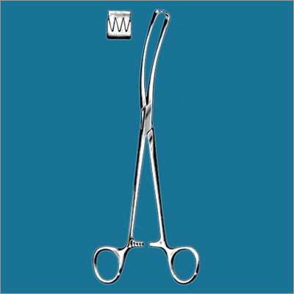
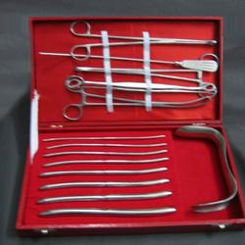
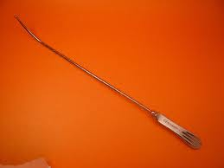
Evidence of abortion in living
Examination of genitalia- vaginal lacerations, abrasions, perforations, cervical lacerations, injuries due to instruments on the cervix – it could be surgical or following criminal abortion

Slide 32
Difficulties in establishing criminal abortion in the living
History is often less informative
Lack of cooperation from the patient
Signs of pregnancy may be minimal in the early stages of pregnancy
If the criminal abortion performed by skillful person minimal or no complications ( no injuries in the genital tract)
The place where it is done is cleaned and cleared
Signs of local interference or instrumentation may get masked by surgical procedures
Delay in presentation following criminal abortion (findings of pregnancy and recent delivery will disappear with time)

Slide 33
Duties of a Medical officer
History, examination, investigation and management of the patient
Document the injuries and the general condition of the patient
Collection of specimens – all foreign bodies and products of conception
Inform the police and the JMO
If MLEF is issued discharge only after seen by the JMO/MO- Medico legal
If the condition is bad arrange a dying declaration
If death takes place request for an inquest

Slide 34
Duties of a Medical officer
Ethical aspects
Obtain informed written consent for surgical procedures and genital examination
Uphold professional secrecy- No information about a patient’s condition should be divulged to others without permission from the patient or his next of kin when the patient is incompetent.

Slide 35
Diagnosis and investigation of a death following criminal abortion
Important issues to be addressed
Establish a pregnancy
Period of gestation
Abortion taken place or not
Whether induced or not
If induced the method used
Determine the cause of death
Whether the cause of death has any causal link with the method used for abortion

Slide 36
Autopsy in abortion deaths
History
Visit to the scene
Identification
Preliminary procedures
Clothing
General external examination
Specific external examination
Internal examination
Laboratory investigation
Documentation

Slide 37
History
Married/ Unmarried/Pregnant out of wedlock
Period of Amenorrhea, Abdominal pain, bleeding per vaginum
Reason for abortion
Done with consent or not
Identity of the person and place
Medicines/Injections given
Methods used
Events after abortion- clots, passage of foetal products, fever, discharge

Slide 38
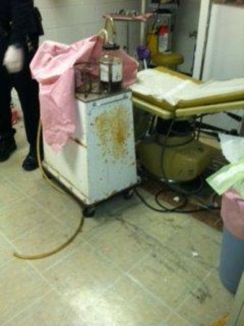
Visit to the Scene
Recover medicines and instruments used for the abortion
Recover trace material such as shaved pubic hair, blood stained cloths and sanitary towels
Recover foetus or foetal products
Rarely the body of the dead woman

Slide 39
Identification
Usually not a problem
But there can be instances where a false history or false identification may be provided

Slide 40
Preliminary procedures
Photography- signs of pregnancy, criminal intervention, injuries
X-rays‘ – Preautopsy radiology of the chest and abdomen for air embolism
USS scan – diagnosis of pregnancy and abortion
Trace material- chemicals , foreign bodies

Slide 41
Clothing
Identification
Proof of evidence such as haemorrhage
Trace evidence

Slide 42
Specific external examination
Abnormal colouration of the skin
Signs and duration of pregnancy
Signs of injury
Vagina- signs of current or recent pregnancy, signs of attempted or successful recent abortion, swabs for culture, fluid for chemicals

Slide 43
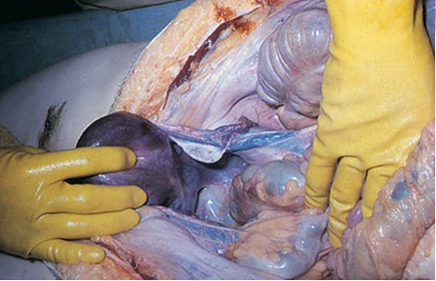
Internal examination
A special pelvic dissection is performed in suspected cases of criminal abortions
Exclude natural causes for spontaneous abortions- diabetes, heart disease
Cause of death- Haemorrhage, Septicaemia,renal failure etc
Examination of the uterus
Examiantion of the genital passages

Slide 44
Examination of the uterus
Colour, size, texture
State of the interior- necrosis, sepsis
If the chorionic sac present – integrity, attachment to the decidua
Foetus present or not
Products of conception, placental bed, tubes, ovaries- presence of corpus luteum
Evidence of abortion – injuries to uterus
Histological samples

Slide 45
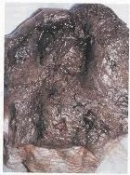
Septic necrotic uterus

Slide 46
Examination of the genital passages
Abrasions, bruises, lacerations and any foreign material are noted in the vagina
Samples kept for chemical and microbiological analysis
Cervix- instrument marks such as forceps and volsellum teeth
State of dilatation of the cervical canal

Slide 47
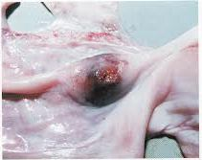
Ruptured tube in ectopic pregnancy

Slide 48
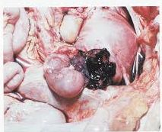
Placenta and fetus in the abdominal cavity

Slide 49
Special pelvic dissection
The pelvic organs should be removed enbloc
The lower end of the abdominal incision is carried around each side of the labia and into the cleft of the buttocks to include the anus.
The dissection is taken along the superior pubic rami which are carefully sawn through a few centimeters laterally to the symphysis on each side

Slide 50
Special pelvic dissection
The central block of bone is removed and the perineal incision dissected deeply
Cut the peritoneum along the pelvic brim
The vagina, rectum, anus, uterus, tubes and ovaries can be lifted out in continuity and removed for detailed dissection
Examine all organs externally before dissection
The vagina is carefully opened along one side
Similarly the uterus is also opened carefully along one side

Slide 51
Laboratory investigations
Toxicology- chemicals from vagina etc
Histopathology- diagnosis of pregnancy
Serology (DNA)- linking the fetus with mother

Slide 52
Documentation
Pregnancy and period of gestation
Evidence of abortion
Evidence of induced abortion
Method used
Sequelae- recovery, complications or death (cause of death)

Slide 53
Reference
1. Lecture notes in Forensic Medicine- Volume 1Dr LBL de Alwis
2. Knight’s Forensic Pathology 4th edition
3. A maternal death due to illegal abortion - case report (Perera WNS, ParanitharanP)Sri Lanka Journal of forensic medicine science and law (available in the internet)
4. Penal Code. Legislative enactments, Government of Ceylon. 1970
5. Legal aspects of medical practice. Bernard knight. 5th edition

Slide 54


